Slide 1
Cloud Computing
Unit 5

Slide 2
MicroStrain’s SensorCloud is a unique sensor data storage, visualization and remote management platform that leverages powerful cloud computing technologies to provide excellent data scalability, rapid visualization, and user programmable analysis. MicroStrain’s SensorCloud™ is a unique sensor data storage, visualization and remote management platform that leverages powerful cloud computing technologies to provide excellent data scalability, rapid visualization, and user programmable analysis. Originally designed to support long-term deployments of MicroStrain wireless sensors, SensorCloud now supports any web-connected third party device, sensor, or sensor network through a simple OpenData API.

Slide 3
Core SensorCloud features include: Virtually unlimited data storage with triple-redundant reliability, ideal for collecting and preserving long-term sensor data streams Time series visualization & graphing tool with exceptionally fast response, allows viewers to navigate through massive amounts of data, and quickly zero in on points of interest MathEngine feature allows users to quickly develop and deploy data processing and analysis apps that live alongside their data in the cloud Flexible SMS and email alert scripting features helps users to create meaningful and actionable alerts

Slide 4
SensorCloud is useful for a variety of applications, particularly where data from large sensor networks needs to be collected, viewed, and monitored remotely. Structural health monitoring and condition based monitoring of high value assets are applications where commonly available data tools often come up short in terms of accessibility, data scalability, programmability, or performance. MicroStrain’s SensorCloud was born out of a need for a better tool for these types of applications but the core features and benefits can add value to a much broader range of applications.

Slide 5
Visualize.
Unlike previous web-based sensor data aggregation platforms, SensorCloud is unique in that it leverages several new cloud computing technologies to make it easier to work with extremely large data sets. SensorCloud graphing functions utilize parallel computing and client side caching to accelerate responses to user graphing requests. The result is a high-performance web data visualization tool that typically generates plots in under a second, and allows users to quickly navigate through gigabyte, terabyte, and even petabyte sized data sets.

Slide 6
Analyze.
SensorCloud is also unique in that it is the first web-based sensor data aggregation platform that provides a flexible online analytics tool supporting user-developed apps. SensorCloud’s MathEngine allows users to quickly develop and deploy data processing apps in either Python and Octave (an open-source, code compatible MATLAB® alternative), and will soon support the popular R statistical language, giving users programming language flexibility to best suit their needs. Users can either upload their code or use an online editor to develop a wide range of data processing apps, from simple one-time scripts for filtering and statistical analysis, to advanced, continuously-running online algorithms for health monitoring and prognostics.

Slide 7
Collaborate.
Cloud computing continues to change how we produce, consume, and share information. In similar respect, SensorCloud changes how teams share and work with sensor data. With secure HTTPS/SSL web access standard, SensorCloud simplifies data sharing and analysis for team members spanning multiple locations, it helps groups better coordinate event responses with flexible alerts, and it allows teams to collaborate on code development for MathEngine apps. Data owners can also expand their audience by sending invites to domain experts to view their data set, assist with analysis, and develop advanced, custom-tailored data processing applications.

Slide 8
Scale.
Cloud computing has reduced barriers and costs associated with access to powerful computing capabilities previously reserved for expensive enterprise systems, while at the same time bringing new tools and techniques that exceed enterprise system performance and scalability. MicroStrain’s SensorCloud seeks to transition these new and unique cloud capabilities into tools that make it easier for our customers to collect and visualize large quantities of sensor data, and extract meaningful insight with user-programmable online analytics.

Slide 9
Conceptualization of Sensor-Cloud
In this work, we present a mathematical formulation of sensor-cloud, which is very important for studying the behavior of WSN-based applications in the sensor-cloud platform. We also suggested a paradigm shift of technology from traditional WSNs to sensor-cloud architecture. A detailed analysis is made based on the performance metrics – energy consumption, fault-tolerance, and lifetime of a sensor node. A thorough evaluation of the cost-effectiveness of sensor-cloud is also done by examining the cash inflow and outflow characteristics from the perspective of every actor of sensor-cloud.

Slide 10
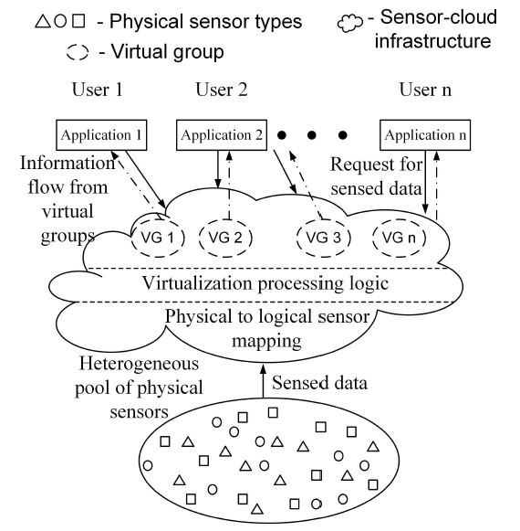

Slide 11
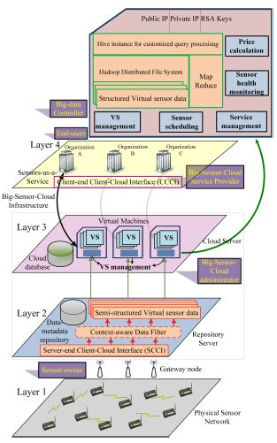
Big-Sensor-Cloud Infrastructure
This work relates to the development of Big-Sensor-Cloud Infrastructure (BSCI) that immensely enhances the usability and management of the physical sensor devices. BSCI is a distributed framework for “Big” sensor-data storage, processing, virtualization, leveraging, and efficient remote management. The methods of the proposed BSCI are persuasive as they are equipped with the ability to handle “Big” data with enormous heterogeneous data volumes (in zettabyte) generated with tremendous velocity. The framework interfaces between the physical and cyber worlds, thereby acquiring real-time data from the physical WSNs into the cloud platform.

Slide 12
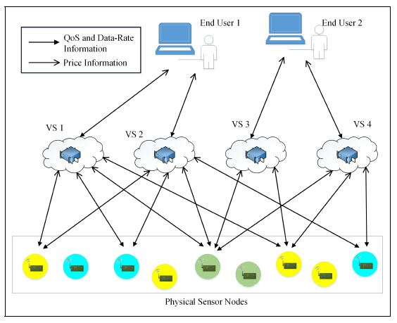
Virtual Sensor Formation in Sensor-Cloud
In this work, the problem of dynamic mapping of virtual sensors in sensor-cloud is divided into two subproblems — optimal dispersed node selection and optimal data-rate distribution, and analyze that these problems are NP-complete. Hence, we propose a game theory-based online scheme, named QADMAP, to solve these two problems in polynomial time.

Slide 13
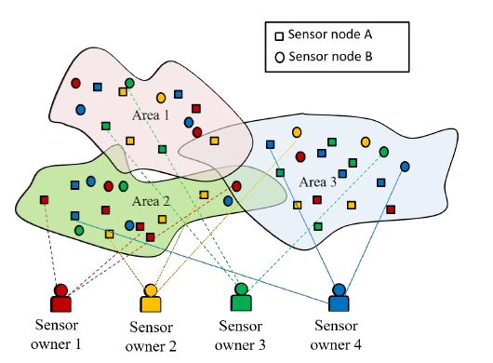
Economic Model for Virtual Sensors
In this work, we propose a scheme for the formation of DynamIc VIrtual Sensor for Overlapping Region (DIVISOR) in a IoT-based sensor-cloud platform. Using DIVISOR, we ensure that each sensor-owner gets an equal opportunity to earn profit from the deployment of his/her sensor nodes.

Slide 14
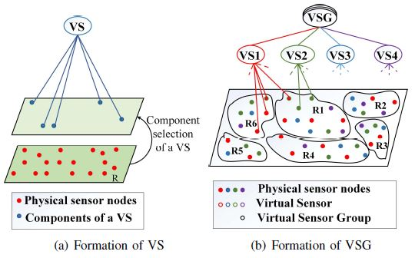
Composition of Virtual Sensors
In this work, we propose algorithms for efficient virtualization of the physical sensor nodes and optimal composition of VSs — within the same geographic region (CoV-I) and spanning across multiple regions (CoV-II).

Slide 15
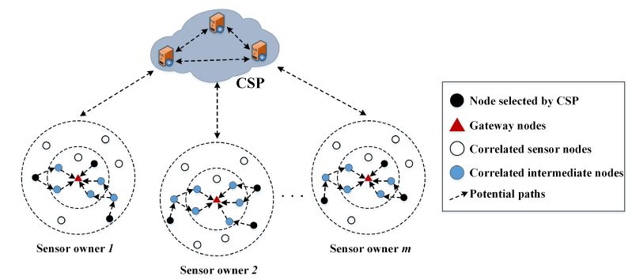
Energy Efficient Virtual Sensors,
In this work, we present a dynamic virtual sensor provisioning scheme (DVSP) for sensor-cloud based IoT applications to maintain the energy-efficiency of the deployed physical sensor nodes while maintaining the QoS of the service requests. We model the interaction between the Cloud Service Provider (CSP) and the Sensor owners (SOs) using the Single-Leader Multi-Follower Stackelberg game.

Slide 16
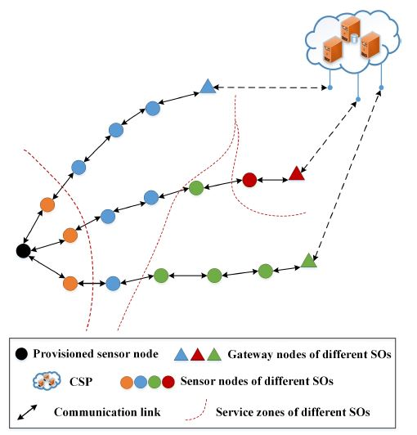
Intelligent Dynamic Virtual Sensors
In this work, we argue that the collaboration between the Cloud Service Provider (CSP) and sensor owners (SOs) can improve dynamic virtual sensor provisioning. We propose a scheme named Intelligent Dynamic Virtual Sensor Provisioning (iDVSP) to enable optimal selection of nodes in a multi-hop path with different SOs. We employ multi-unit single-item combinatorial reverse auction to model the interaction between the CSP and SOs.

Slide 17
For most of the people reading this article, chances are that you live in a city. In fact, more than 55% of all the people in the world live in cities and urban areas, a number which may increase to 70% in the future as urbanization increases and people migrate to the cities in search of jobs. But this means that cities need better planning and infrastructure if they have to be energy efficient and environmentally friendly to provide a good quality of life. In other words, cities need to become smart cities! This is possible using a combination of the Internet of Things with sensors collecting data and machine learning implementing the insights obtained from the data.

Slide 18
IoT can be used in many ways to make cities more efficient ranging from managing the traffic, controlling air pollution, handling waste management, creating smart buildings, planning for natural disasters, etc. So let’s see how modern technologies combined with civic planning can result in smart cities that are more efficient and cost-effective.

Slide 19
1. Traffic Management It is important to control the traffic in cities otherwise there are huge traffic jams in popular places and totally empty streets otherwise. This also depends on the design and layout of the roads but it can be managed by having smart traffic lights. For example, the traffic lights should automatically adjust according to the volume of the traffic so that green lights should have a longer duration where there more traffic and shorter duration when the streets are empty. Sensors can also be embedded in roads and bridges to monitor their conditions so that they can be repaired when there is much wear and tear. After all, roads with potholes are also a major cause of traffic pollution!

Slide 20
2. Air Pollution Air pollution is a major problem in many metropolitan cities where the particulate matter in the air is so high it is damaging to the lungs in the long run. But IoT along with machine learning can be used to reduce air pollution. This is possible by collecting data related to city pollution like emissions from vehicles, pollen levels, airflow direction, weather, traffic levels, etc using IoT from various sources and then calculating pollution forecasts to see the trends in pollution so they can be controlled.

Slide 21
3. Healthcare Healthcare is an extremely important aspect of life, especially in current times when non-communicable diseases like heart problems and cancer are increasing in big cities while there are still a lot of deaths from infectious diseases in poorer places. In such a situation, IoT technology can surely help in enhancing the healthcare system so that the best healthcare is received by everybody. One example of this is microbots that can directly enter the bloodstream and reach any place inside the body to deliver medicines. Another application of IoT and sensors in healthcare is remote patient monitoring wherein patients can be monitored 24/7 and emergency responders called if there are any problems.

Slide 22
4. Public Transport Public transport, whether it be buses or trains, are at the heart of any city. This is especially true in big cities where there are big traffic jams and the metro train can be a lifesaver! However, smart public transport can streamline traffic and also make commuters’ life much easier. It is very convenient when the trains and buses are connected with a single app and you know exactly when the next service will arrive and how long you need to wait. In addition to that, predictive analytics can be used to optimize the routes of public transport which provide maximum benefit and minimum cost.

Slide 23
Water Management There is no life without water! But water is also a finite resource which is reducing at an alarming rate. Therefore, using smart water management techniques in cities so that water can be conserved for future generations is a good idea. Sensors can be used to monitor water levels, pipe conditions, tank pressures, etc. in municipal water pipelines and tanks to optimize water management. These will ensure that water is not wasted and that problems like leaky pipes or high pressure in tanks can be handled without any loss of water. Sensors can also be used to monitor the groundwater levels so that they can be replenished if there is a groundwater shortage

Slide 24
.Buildings Cities are obviously incomplete without buildings and larger cities have a lot of skyscrapers as well. Now the challenge is to build smart buildings using IoT where all the functionalities like lighting, air conditioners, heating, security, etc. can be connected and controlled from a single source. This will reduce the costs of operating a building as well as increase efficiency. For example, air conditions and heaters in a building can be set to change the internal temperature according to the outside temperature. Sensors can also be used to monitor the air quality inside the building and also automatically switch on lights only when there are people. All these actions will save a lot of energy and also reduce the electricity bill!

Slide 25
Waste Management Waste management systems in a city can be optimized so that there is efficient waste collection and disposal which helps in keeping the city clean and hygienic. After all, mismanagement of waste can lead to contamination of the soil, air, and water as well as provide a breeding ground for a host of bacteria (not to mention the horrible smell!) But IoT technology with sensors in the waste bins can be used to find when the bins are full and dispose of them accordingly. This is better than just disposing the waste on particular days only when the bind might not be full sometimes or overflowing with the danger of contamination on other days.

Slide 26
Parking It doesn’t sound like parking is a problem but it is actually a big headache, especially in large cities. Less available space means that drivers have to waste their time finding parking spaces and increase road traffic in this process ( while also becoming more and more irritated!) This issue can be solved by using IoT connected sensors around the city that point out the empty parking spaces around wherever your destination is. This data will also allow city officials to see where there is congestion due to less parking space and where there is lots of empty space available. This can then be used to optimize parking and prevent traffic jams as well as driver irritation!

Slide 27
Natural Disaster Management It is not possible to prevent natural disasters like hurricanes, earthquakes, tsunamis, etc. but it is entirely possible to anticipate these disasters before they occur and then manage them effectively. For example, sensors in combination with IoT can be used to anticipate when earthquakes are going to occur by analyzing the makeup of the ground, seismic plate interaction, energy propagation in the ground, etc. Similarly, sensors can be used to obtain flood detection data like river level readings, rainfall records, terrain and elevation of an area, etc. to predict when and where a flood might occur and the severity of the flood as well.

Slide 28
Infrastructure The infrastructure of a city i.e. its roads, buildings, etc are essentially what form the city. And smart infrastructure is a very important part of creating a smart city. This includes using IoT along with sensors to use technology intelligently which can save energy and cost for a city. An example of this is using smart streetlights along the roads that only turn on when they detect motion and stay off the rest of the time. This will definitely save energy and reduce the cost to the city.

Slide 29
Smart homes
Smart homes connect the devices and home appliances together in order to improve efficiency. These interconnect devices under one roof such as geysers, ovens, smart TVs, thermostats and allow communication between the devices. IoT connects these devices to the internet and these devices constantly send and receive information about the surroundings. The devices send the data to giant cloud servers mostly via IoT gateways. Smart homes allow users to remotely monitor their devices via mobile applications. Applications of smart homes also include home security systems, smart thermostats and smart refrigerators. Smart homes cities integrate with the entire cities by creating and controlling a network.

Slide 30
Smart thermostats
The Smart homes include thermostats that are capable of sensing and controlling the temperature. This controls the flow.
Location-based smart devices
Smart devices can track your location and instantly send messages to other devices to operate. For example, your smart thermostats can track your location from a smart car and switch on the ACs before you arrive

Slide 31
Voice-enabled devices
These devices can interpret human voices and convert these into text that is interpreted by the machines. Machines then perform the necessary task. Examples include alexa and siri. Smart security systems Security systems that are made using IOT use features such as facial recognition, iris scanners and other security modes.
Facial recognition
This is one of the most propelling uses of the IoT. facial recognition models track the features of the face such as the yes, noses, chin and lips to predict the output of the person. Based on the accuracy the machine is further trained or sent for development.

Slide 32
Motion detection
Similar to facial detention but here the sensors record the movements or changes on the surroundings. These behavioural changes are then sent to the model for further analysis.
Biometric access control
Biometrics have become the backbone of any organisation’s security systems. They are easy to manage and hassle-free. The employees and the staff members simply record their thumb or iris impressions on arrival and the machine marks their attendances. This model saves time and cost.

Slide 33
Benefits for smart homes
Smart homes allow you to add improvised functionality into regular homes. These make lives easier. For instance, smart vacuums clean up your entire home when you are away and smart refrigerators stock up your fridge and manage your die charts. Smart homes offer security, stability, flexibility and peace of mind.

Slide 34
Challenges in smart home systems
Although there is no doubt that smart homes immensely make the lives of humans easier. It comes with the following challenges
It becomes difficult to integrate the system when each one of the IoT devices is sold by different vendors
Many times the IOt devices are not compatible with each other. Each of the devices must be connected to the WiFi in addition to being connected to devices such as Google Assistant.
The prices of setting up smart homes are highly expensive and so the customers may not prefer to make such a hefty investment when regular homes just work fine without IoT.
Security is still a big threat in smart homes. Smart homes must have a powerful farewell in order to avoid system hacking

Slide 35
IoT Smart homes for smart citizens
A city with smart homes does not necessarily mean expensive houses with tight security. However, it is necessary to have some security on personal and public networks so the city is safe from crimes such as theft.
By ensuring devices are protected we ensure the fundamental growth of the city. We can monitor our personal assets remotely and this is all possible due to the internet of things. Smart homes help in saving time and costs for example thermostats manage the temperature of your home and control your expenses. Similarly, if we apply this concept on a city level we can reuse and save energy to a much larger extent.

Slide 36
Smart cities are much safer. These include smart traffic control, pollution control, smoke detectors, security cameras near every public area, and so on. Smart security systems reduce crime rates in any city by a large percentage.
Smart homes with IoT technology create a much easier and helpful living space for their residents. Cities become safer and easier to control. Smart cities contain responsible and dutiful citizens and residents.

Slide 37
A connected vehicle is one that is capable of connecting over wireless networks to nearby devices. Connected vehicles are an important factor in the advance of IoT. The use cases range from connected entertainment systems that connect with the driver’s mobile phone to Internet-connected vehicles that have bi-directional communication with other vehicles, mobile devices and city intersections. Connected vehicle is an Internet of Things (IoT) technology with broad implications. As we shared in our blog post, Safety Trends in Traffic Management, connected vehicle technology is part of the Intelligent Transportations Systems government initiative, and there are many active trials around the world today.

Slide 38
One of the primary use cases for the IoT car is safety, via rapid vehicle-to-vehicle and vehicle-to-roadside unit communications (also known as V2X). But there are many other examples of connected vehicle technology at work in the automotive IoT space as well, as we will explore

Slide 39
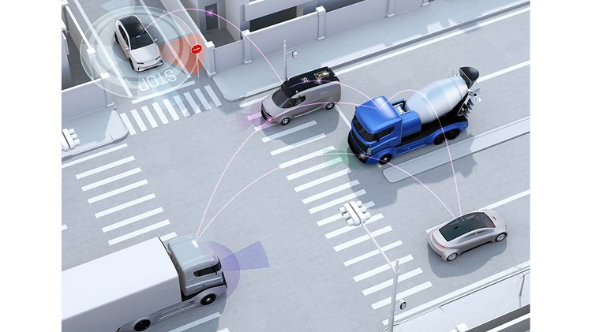
How Does Connected Vehicle Work?
Connected vehicles connect to a network to enable bi-directional communications between vehicles (cars, trucks, buses and trains) and other vehicles, mobile devices and infrastructure for the pupose of triggering important communications and events. In the case of city traffic and intersection safety, for example, those communications can enable vehicles outfitted with connected vehicle technology to continuously communicate their locations and to receive near real-time information that triggers an automated response.

Slide 40
The connected vehicle government fact sheet provides a concise, easy-to-understand description: Cars, trucks, buses, and other vehicles will be able to “talk” to each other with in-vehicle or aftermarket devices that continuously share important safety and mobility information with each other. Connected vehicles can also use wireless communication to “talk” to traffic signals, work zones, toll booths, school zones, and other types of infrastructure. The vehicle information communicated is anonymous, so vehicles cannot be tracked and the system is secure against tampering. These communications will have a range of effects, which we will discuss next.

Slide 41
Examples of Connected Vehicles at Work in the IoT
With vehicles becoming more sophisticated and more connected, cars today are connecting to more sophisticated, high-bandwidth networks, in order to enable a range of capabilities. For example, automotive IoT enables high-speed vehicle-to-vehicle and vehicle-to-infrastructure communications to trigger the following results, many of which are possible today:
Adaptive cruise control
Automatic route planning based on real-time conditions
Traffic redirected away from congestion
Automatically updated road signage, to report traffic or conditions
Communications to drivers, notifying them of crash sites or wrong-way drivers ahead
Automatic vehicle braking to prevent collisions (in trials)
Autonomous and semi-autonomous vehicle control (in trials)

Slide 42
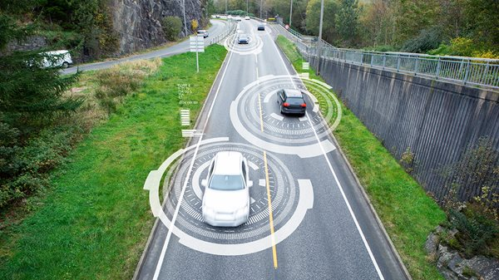
GPS is one example of a technology that supports connected vehicle, as the GPS network allows a car to plan a route, taking into account current traffic conditions to avoid traffic jams. The sophistication of GPS and its use by connected vehicles will continue to evolve with lower-latency networks and the advance of connected vehicle technology. OnStar is another example, with a car connecting to an OnStar representative so that a driver can get assistance when needed. Today, connected vehicles are being equipped with 4G receivers to create an in-vehicle hotspot.

Slide 43
How Will 5G Networks Impact Connected Vehicle Technology?
Soon, connected vehicles will be built with 5G receivers and transmitters. A 5G module will allow connected vehicles to communicate with each other in near real time. As a simple example, two cars going in opposite directions could share road conditions based on where they’ve just been. One of the most interesting IoT use cases is that connected vehicles can transmit data about how they’re driving. For example:
Self-driving cars will communicate their position, which will allow them to safely drive side by side as well as merge at high speeds.
Connected vehicles will communicate at stoplights and stop signs to determine which vehicle has the right of way.
A vehicle will also be able to connect to a city’s network to find parking, locate a business or residence, or avoid areas with construction or congestion.

Slide 44
As Tesla has shown, self-driving cars can generally do okay on highways and other roads that don’t have complex obstacles. However, today autonomous vehicles do not safely navigate difficult intersections and other obstacle-ridden areas in dense cities. With enough sensors and cameras, and the high-speed, low-latency communications that 5G networks will deliver, the future IoT car will ultimately be able to navigate safely through these difficult zones.

Slide 45
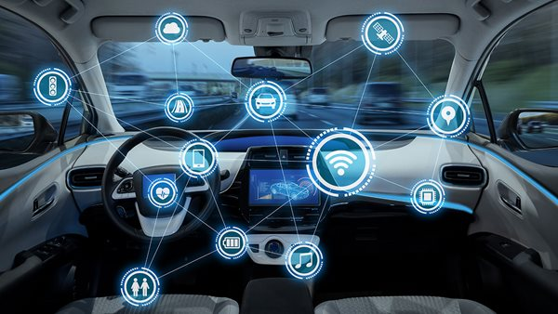
Internal On-Board Use Cases for Connected Vehicle Technology
Internally, a connected vehicle is designed to connect to a driver’s or passenger’s smartphone, to vastly increase the functionality beyond playing music or routing a phone call through the car’s speakers. For example:
The connected vehicle can be turned on or off with a smartphone.
The vehicle can share diagnostic data and remind the owner about upcoming service requirements, such as oil changes.
In the event that the vehicle is stolen, it can share its location.
The owner can use an app to have the flash its headlights in the parking lot so that the car stands out.

Slide 46
The Communications Backbone for Connected Vehicle
The infrastructure supporting smart city and automotive IoT initiatives like Intelligent Transportation Systems (ITS) will help connected vehicle systems to reach their full potential. Today, these deployments use sensors, cameras and RFID readers to monitor intersections and roadways to identify congestion, automatically reroute traffic, identify distances to various destinations and update signage. And public safety will improve, as intersections become safer for pedestrians and cyclists, and adaptive traffic lighting enables emergency responders to get to accident scenes faster.

Slide 47
As networks continue to advance and AI capabilities improve, the capabilities of traffic management systems will continue to advance as well; for example they will be able to monitor traffic in real time and use historical data to identify where traffic buildup is likely before it happens. Smart cities are deploying these systems for their excellent traffic management capabilities today, and their more sophisticated connected vehicle capabilities tomorrow.

Slide 48
Today, Digi cellular routers are providing the mission critical communications for these deployments, with over 20,000 intersections installed at this writing. With Gigabit Ethernet speeds, multiple ports and compute power, Digi transportation routers are IoT solutions that provide the needed speed, compute power and connectivity to manage the full range of devices at work in today's complex traffic management scenarios, while paving the way for the connected vehicle future. Most importantly, cities can deploy these systems today to dramatically improve the effectiveness of their entire traffic management system while reducing the cost and complexity of their infrastructure and preparing for the next generation of connected vehicle.

Slide 49
IoT for Smart Grid: Benefits and Applications
In the dynamic realm of smart energy, the integration of the Internet of Things (IoT) is reshaping the landscape, bringing as a result IoT energy solutions; this is taking energy management to an era of unparalleled efficiency and sustainability. Let’s see in this article the several applications and implications of IoT for smart grids.

Slide 50
What is a smart grid?
A smart grid is an intelligent electricity network that leverages advanced technologies to enhance the reliability, efficiency, and sustainability of energy delivery.
Such smart grids encompass a sophisticated system of sensors, communication networks (see IoT framework), and data analytics to optimize the generation, distribution, and consumption of electricity.
In smart grids, consumers can become producers of energy because of solar energy, wind turbines, and other energy sources. People can rely on a smart meter IoT for better energy management at their homes, and even, these smart meters can be used inside companies for energy efficiency.

Slide 51
How does smart grid technology work?
Smart grid technology operates on a two-way communication model, enabling seamless interaction between various components. It involves the integration of sensors and IoT devices across the grid infrastructure, allowing real-time data collection.
This data is then analyzed (See IoT monitoring dashboard) to optimize energy flow, detect failures, and respond dynamically to changing demand patterns.

Slide 52
IoT applications in smart energy
1. Grid monitoring and management
IoT facilitates real-time monitoring of the entire grid infrastructure. Sensors deployed across substations and transmission lines capture data on voltage, current, and other vital parameters. This data is transmitted in real-time, enabling utilities to monitor grid health, detect abnormalities, and proactively address potential issues.

Slide 53
Demand response optimization IoT-enabled smart grids empower utilities to implement demand response programs efficiently. By integrating smart meters and IoT devices in homes and businesses, utilities can remotely manage and optimize energy consumption during peak hours, reducing strain on the grid and minimizing the need for costly infrastructure upgrades; see IoT in energy management.
Distributed energy resources integration Smart grids leverage IoT to seamlessly integrate renewable energy sources, energy storage systems, and electric vehicles. This integration allows for efficient management of distributed energy resources, optimizing their contribution to the grid and ensuring a smoother transition to a cleaner, more sustainable energy ecosystem.

Slide 54
Predictive maintenance IoT sensors play a crucial role in predictive maintenance, offering real-time insights into the condition of grid components. By continuously monitoring equipment health, utilities can identify potential failures before they occur, reducing downtime, lowering maintenance costs, and improving overall grid reliability.

Slide 55
Smart grid examples
Smart grid applications encompass a diverse array of functionalities, including systems for monitoring and optimizing thermal efficiency, optimizing layout designs, analyzing energy costs, collecting metrics and feedback from consumers, real-time data processing, and grid operations automation. For instance, Advanced Metering Infrastructure (AMI) exemplifies the synergy between IoT and smart grids. Smart meters equipped with IoT capabilities enable utilities to collect and analyze consumption data remotely.

Slide 56
This is a great ally for accurate billing, demand forecasting, and proactive energy management. Our smart energy meter is the best example of a smart grid application that delivers outstanding results. Microgrids are another example of IoT in smart grid. They are powered by IoT, exemplifying decentralized energy systems. By integrating sensors and IoT devices, microgrid operators can monitor and control energy generation, storage, and distribution within the microgrid, ensuring optimal performance and resilience.

Slide 57
As IoT continues to evolve, the potential applications in smart energy are limitless. The convergence of artificial intelligence, machine learning, cloud computing, 5G, and IoT promises even greater advancements in grid optimization, cybersecurity, and resilience (see 5G pros and cons). DeepSea Developments is among the best electronic product design companies that build reliable devices for sectors such as consumer electronics, healthcare, mobility, and fleet tracking. On the other hand, if you are looking for smart energy solutions, you can click on the button below to learn more about our smart energy meter.

Slide 58
What Is Industrial IoT (IIoT)?
Industrial IoT is an ecosystem of devices, sensors, applications, and associated networking equipment that work together to collect, monitor, and analyze data from industrial operations. Analysis of such data helps increase visibility and enhances troubleshooting and maintenance capabilities. It can also increase efficiencies, reduce costs, and improve safety and security.

Slide 59
Why should organizations consider adopting industrial IoT? Industrial IoT enables organizations to get a wealth of actionable data from their operations. When properly aggregated and analyzed, the data helps them better control operations, with the potential to: Improve worker safety Increase production uptime by predictive maintenance of machinery Maintain product quality Help ensure regulatory compliance Improve operational efficiencies Accelerate response times with real-time collection and processing of operational data

Slide 60
How is industrial IoT different from other types of IoT? IIoT connects machines and devices in industries such as manufacturing, transportation, oil and gas, power generation and transmission, mines, and ports. Commercial, enterprise, or consumer IoT—also simply known as IoT—is used to describe connected devices within homes and office spaces, such as cameras, badge readers, and HVAC control systems. Failure of IIoT can have catastrophic consequences, creating high risk and potentially life-threatening situations. Downtime of other IoT devices may result in inconveniences, but it does not usually cause emergency situations.

Slide 61
The role of IT in industrial IoT IIoT malfunctions can have a major impact on operations, ranging from production downtime to compromising worker safety or damaging the environment. IIoT installations benefit from rigorous IT processes, tools, and best practices. IT can scale and secure IIoT deployments to help ensure success. A reliable network Organizations rely more and more on the quantity and quality of data they get from their operations. IT must strive to ensure that a reliable network with sufficient bandwidth capacity is in place so time-sensitive data can be transmitted without delay to applications in data centers or the cloud.

